Slide 1
Woven in the Womb
What does the Bible say about the Unborn?

Slide 2
Psalm 139:14–16 (ESV)
14 I praise you, for I am fearfully and wonderfully made. Wonderful are your works; my soul knows it very well. 15 My frame was not hidden from you, when I was being made in secret, intricately woven in the depths of the earth. 16 Your eyes saw my unformed substance; in your book were written, every one of them, the days that were formed for me, when as yet there was none of them.

Slide 3
Woven in the Womb
What does the Bible say about the unborn?
What effect do the different stages of human development have on the morality of taking innocent life?
How should we treat unborn children?
How should we respond to the practice of abortion in our society?

Slide 4
They are children/sons
Gen. 25:21-22 - 21 And Isaac prayed to the Lord for his wife, because she was barren. And the Lord granted his prayer, and Rebekah his wife conceived. 22 The children struggled together within her, and she said, “If it is thus, why is this happening to me?” So she went to inquire of the Lord.
Ruth 1:11— 11 But Naomi said, “Turn back, my daughters; why will you go with me? Have I yet sons in my womb that they may become your husbands?
Gen. 3:16 — 16 To the woman he said, “… you shall bring forth children.”
Hebrew: BEN – son/child

Slide 5
They are Male or Female from Conception
Job 3:3 (ESV) — 3 “Let the day perish on which I was born, and the night that said, ‘A man is conceived.’
Hebrew: GEBER – appears 65 times in scripture and always refers to a male human being

Slide 6
They are Infants/Children
Job 3:16 (ESV) — 16 Or why was I not as a hidden stillborn child, as infants who never see the light?
Hebrew: OLAL – appears 20 times in Scripture, always referring to a very young human being
Notes:
A miscarriage involves the death of an infant who will never see the light

Slide 7
They have Family Relationships
Hosea 12:3 — 3 In the womb he took his brother by the heel, and in his manhood he strove with God.
Luke 1:43 — 43 And why is this granted to me that the mother of my Lord should come to me?
Greek: MATER 82x, always refers to a female who has brought or is bringing a new human being into the world

Slide 8
They are Babies
Luke 1:41 (ESV) — 41 And when Elizabeth heard the greeting of Mary, the baby leaped in her womb.
Greek: BREPHOS, appears 8x in the NT, always of a human baby distinct from its mother

Slide 9
They are the Same Thing at Birth that they are at Conception
Luke 1:36 - And behold, your relative Elizabeth in her old age has also conceived a son
Luke 1:57 - Now the time came for Elizabeth to give birth, and she bore a son.
Greek: HUIOS - son

Slide 10
They Bear the Image of their Father from Conception
Genesis 5:1–3 - When God created man, he made him in the likeness of God. 2 Male and female he created them…. 3 When Adam had lived 130 years, he fathered a son in his own likeness, after his image, and named him Seth.
Seth received the likeness and image of Adam when he was fathered/begotten/conceived
He received the image of God at the same time! Genesis 1:27
Notes:
When

Slide 11
They Deserve the Same Legal Protection as other Human Beings
Exodus 21:22–25 - “When men strive together and hit a pregnant woman, so that her children come out, but there is no harm, the one who hit her shall surely be fined, as the woman’s husband shall impose on him, and he shall pay as the judges determine. 23 But if there is harm, then you shall pay life for life, 24 eye for eye, tooth for tooth, hand for hand, foot for foot, 25 burn for burn, wound for wound, stripe for stripe.
Notes:
Hebrew: YELED – child, son, boy, youth; appears 89x always referring to a human child
Hebrew: NEPHESH – life, soul, person –
His life is of equal value with the one who caused harm
Life is contrasted with body parts. The unborn child is not part of the woman’s body. The unborn child HAS body parts, which if they are lost, demand retribution. The unborn child has the same kind of life that the violent man must forfeit if he is responsible for the child’s death.

Slide 12
Woven in the Womb
What does the Bible say about the unborn?
What effect do the different stages of human development have on the morality of taking innocent life?
Notes:
Consider in reverse order the stages of development of a human being from conception to adulthood. At each stage, ask yourself if it is morally right to kill an innocent person at that stage of development. May we kill it if it was conceived out of wedlock, or would live in poverty, have a deformity, or even it if was conceived a result of rape?

Slide 13

Adult
Notes:
The adult is fully grown. All body parts are functioning, but growth has ended. May we kill it for no wrong that it has done, simply because we choose to do so?

Slide 14
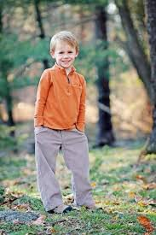
Childhood
Notes:
At this point all body parts are functioning, but it is still growing. May we kill it?

Slide 15
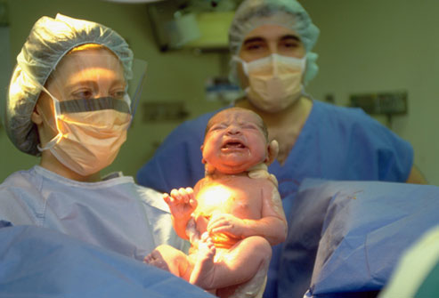
Birth
Notes:
The baby is functioning in all its parts and growing rapidly. It may not look much like it will in adulthood, but it is fully a human individual. May we kill it?

Slide 16
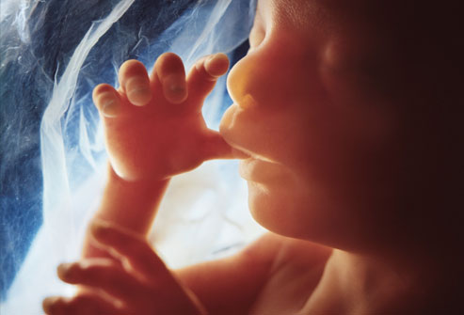
4-9 Months
Notes:
The baby is functioning fully in all its body parts and growing rapidly. The only difference from after birth is where it lives and how it gets its air and food. May we kill it?

Slide 17
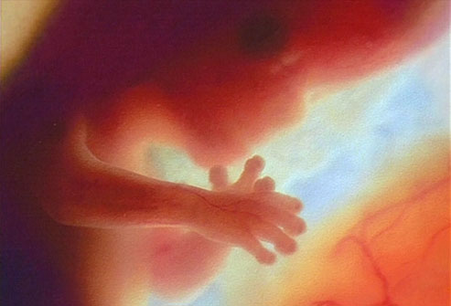
3 Months
Notes:
It can move arms and legs (but the mother cannot feel it). All body systems are present and operating; nothing new will be added from this point. The baby simply grows. Legally it may be killed with practically no restrictions during the first three months, and with few restrictions afterwards. But why would it be right to kill it now, but wrong a few months from now?

Slide 18
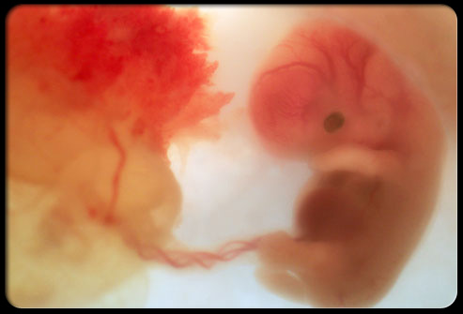
Two Months
Notes:
Fingers and toes are clearly distinguishable. Reproductive organs are developing. Bones are forming. It is clearly recognizable as human. Six weeks after conception brain waves can be measured. May we kill it? Yet this is the stage that is most preferred for performing abortions!

Slide 19
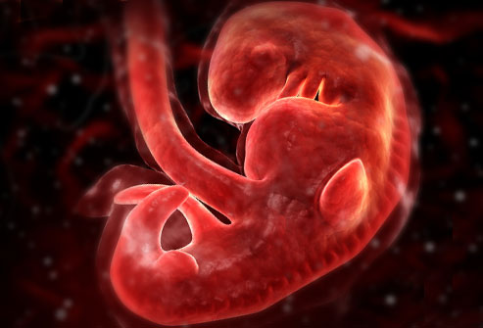
1 Month
Notes:
All major organs have begun developing: brain and nerves, eyes, lungs, stomach and intestines, kidneys, etc. The heart began to beat and circulate blood on the 18th day. The baby has its own blood type, which is often different from its mother's. Yet the mother may not even know she is pregnant.

Slide 20
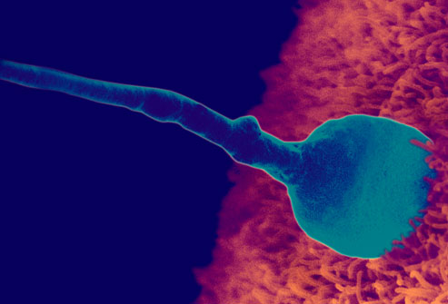
Conception
Notes:
WebMD: At this moment, the genetic makeup is complete, including the sex of the baby.
Job 3:3 – A male is conceived
From the moment of conception, the unborn baby is a unique individual. The genes that determine its physical nature are different from those of any other individual, including its mother and father. Its sex is determined at conception and obviously may differ from the mother's. Each cell in the baby's body is uniquely different from every cell of its mother and every other human.
At what point in this progression is it morally right to kill it, when it has done no wrong, simply because we choose to? How do you prove it is right up to one point but wrong after that point? Human wisdom cannot answer. But the Bible has the answer.
(The above information is summarized from "Life before Birth," Life magazine, April 30, 1965, and other sources.)

Slide 21
Woven in the Womb
What does the Bible say about the unborn?
What effect do the different stages of human development have on the morality of taking innocent life?
How should we treat unborn children?

Slide 22
How should we treat [Unborn] Children?
Titus 2:4 (ESV) — 4 and so train the young women to love their husbands and children,
1 Thessalonians 2:7 (ESV) — 7 But we were gentle among you, like a nursing mother taking care of her own children.
Matthew 18:5 (ESV) — 5 “Whoever receives one such child in my name receives me,
Matthew 22:38–39 (ESV) — 38 This is the great and first commandment. 39 And a second is like it: You shall love your neighbor as yourself.

Slide 23
Counter Examples
Psalm 106:37–38 - They sacrificed their sons and their daughters to the demons; 38 they poured out innocent blood, the blood of their sons and daughters, whom they sacrificed to the idols of Canaan, and the land was polluted with blood.
Ezekiel 16:20–21 - And you took your sons and your daughters, whom you had borne to me, and these you sacrificed to them to be devoured. Were your whorings so small a matter 21 that you slaughtered my children and delivered them up as an offering by fire to them?
Notes:
BEN – the word used for unborn babies in Gen. 21
They are not just your children, they are God’s children,
And in our nation more unborn babies are killed every day than were killed in the 9/11 attacks.

Slide 24
Counter Examples
Genesis 42:22 (ESV) — 22 And Reuben answered them, “Did I not tell you not to sin against the boy? But you did not listen. So now there comes a reckoning for his blood.”
Notes:
Hebrew: YELED used of unborn children in Ex 21
It was a sin to plot to kill him and to otherwise mistreat him. It would be the same if he were unborn.

Slide 25
Counter Examples
2 Kings 8:12 (ESV) - And Hazael said, “Why does my lord weep?” He answered, “Because I know the evil that you will do to the people of Israel. You will set on fire their fortresses, and you will kill their young men with the sword and dash in pieces their little ones and rip open their pregnant women.”
Notes:
The Hebrew word for "children" or "infants" is OLEL, the same word used for the unborn in Job 3:16;
Unfortunately in our nation over a million unborn little ones are dashed to pieces every year, more than the number of soldiers killed in every war in the nation’s history put together.

Slide 26
Counter Example
Matthew 2:16 (ESV) — 16 Then Herod, when he saw that he had been tricked by the wise men, became furious, and he sent and killed all the male children in Bethlehem and in all that region who were two years old or under, according to the time that he had ascertained from the wise men.

Slide 27
Counter Examples
Exodus 1:16–18 -“When you serve as midwife to the Hebrew women and see them on the birthstool, if it is a son, you shall kill him, but if it is a daughter, she shall live.” 17 But the midwives feared God and did not do as the king of Egypt commanded them, but let the male children live. 18 So the king of Egypt called the midwives and said to them, “Why have you done this, and let the male children live?”
Acts 7:19 - He dealt shrewdly with our race and forced our fathers to expose their infants, so that they would not be kept alive.
Notes:
The wicked actions of Pharoah were condemned and punished by God. They would not have been acceptable if the babies had been killed in the womb. These same words are used interchangeably of born and unborn sons, children and infants

Slide 28
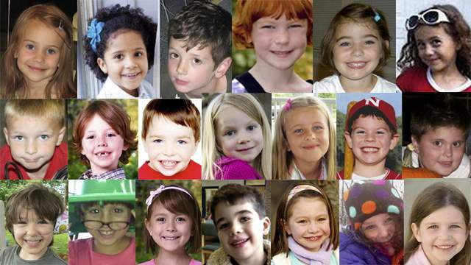
Sandy Hook Victims
Notes:
In Newport, CT James Holmes shot and killed 20 6-7 year-old children on December 14, 2012.
That was not just a great tragedy, it was a horrible evil.
There are twice that many abortions performed every day in the state of Connecticut
https://www.guttmacher.org/statecenter/connecticut.html

Slide 29
Counter Examples
Genesis 9:2–6 - 3 Every moving thing that lives shall be food for you. And as I gave you the green plants, I give you everything. 4 But you shall not eat flesh with its life, that is, its blood. 5 And for your lifeblood I will require a reckoning: from every beast I will require it and from man. From his fellow man I will require a reckoning for the life of man. 6 “Whoever sheds the blood of man, by man shall his blood be shed, for God made man in his own image.
Notes:
We are permitted to take plant and animal life, but not human life. The only exception is as punishment for capital crime. Those who take human life for any other reason are guilty of a capital crime.

Slide 30
Woven in the Womb
What does the Bible say about the unborn?
What effect do the different stages of human development have on the morality of taking innocent life?
How should we treat unborn children?
How should we respond to the practice of abortion in our society?

Slide 31
The Christian Response
Speak and act on behalf of the precious human beings who are being destroyed

Slide 32
The Christian Response
Speak and act on behalf of the precious human beings who are being destroyed
Have compassion on those who are being pressured, deceived or cornered into having an abortion, and show them another way
Notes:
Pressured: In a 2004 study 64% of American women reported feeling pressured to have their abortions
Deceived: It is like having your tonsils removed, nothing more than a clump of cells
Cornered: Many want their babies, but don’t know what else to do: 2004 study 17.7 percent of the American women reported their pregnancy was “desired,” even though abortion was chosen. Thus, perhaps more than 200,000 American women abort desired pregnancies every year.

Slide 33
12 weeks
Notes:
It can move arms and legs (but the mother cannot feel it). All body systems are present and operating; nothing new will be added from this point. The baby simply grows. Legally it may be killed with practically no restrictions during the first three months, and with few restrictions afterwards. But why would it be right to kill it now, but wrong a few months from now?
In VA, A woman must undergo an ultrasound before obtaining an abortion; the provider must offer her the option to view the image. If the woman lives within 100 miles of the abortion provider she must obtain the ultrasound at least 24 hours before the abortion.
https://www.guttmacher.org/pubs/sfaa/virginia.html
In TN, there is no ultrasound requirement, but a woman must receive state-directed counseling and then wait 48 hours before the procedure is provided. Unfortunately, that counseling is most frequently provided by the facility that is getting paid to provide an abortion.
https://www.guttmacher.org/pubs/sfaa/tennessee.html

Slide 34
The Christian Response
Speak and act on behalf of the precious human beings who are being destroyed
Have compassion on those who are being pressured, deceived or cornered into having an abortion, and show them another way
Offer Christ’s healing and forgiveness to those bearing the burden of an abortion

Slide 35
Acts 2:36–38 (ESV)
36 Let all the house of Israel therefore know for certain that God has made him both Lord and Christ, this Jesus whom you crucified.” 37 Now when they heard this they were cut to the heart, and said to Peter and the rest of the apostles, “Brothers, what shall we do?” 38 And Peter said to them, “Repent and be baptized every one of you in the name of Jesus Christ for the forgiveness of your sins, and you will receive the gift of the Holy Spirit.

Slide 36
The Christian Response
Speak and act on behalf of the precious human beings who are being destroyed
Have compassion on those who are being pressured, deceived or cornered into having an abortion, and show them another way
Offer Christ’s healing and forgiveness to those bearing the burden of an abortion
Pray for the end of this barbarous practice

